Slide 1
Market Recap and Look Ahead

Slide 2
Clearwater Toyota August Market Recap – Digital
August Topline Metrics:
Campaign | Ad Group | Impressions | Clicks | CTR
CWT Display 2017 | CWT 2017 Display Contextual | 650,527 | 450 | 0.07%
CWT Display 2017 | CWT Retarget | 217,336 | 542 | 0.25%
CWT Display 2017 | CWT Retarget Bucket 3 | 7,313 | 19 | 0.26%
CWT Display 2017 | CWT 2017 Display Data Super vend | 682,977 | 1,943 | 0.28%
CWT Display 2017 | CWT 2017 Display Data | 442,339 | 840 | 0.19%
CWT Display 2017 | CWT Retarget Bucket 2 | 176,789 | 774 | 0.44%
CWT Display 2017 | Geo fencing | 80,943 | 155 | 0.19%
CWT Rich Media 2017 | CWT Rich Media | 65,236 | 33 | 0.05%
Display |  | 2,323,460 | 4,756
CWT Spotify 2017 | CWT Audio Spot 1 | 14,423 | 9 | 0.06%
CWT Video 2017 | CWT Native Video | 4 | 1 | 25.00%
CWT Video 2017 | CWT 2017 Video Data | 511,605 | 2,108 | 0.41%
CWT Video 2017 | CWT 2017 Video Contextual | 448,922 | 1,291 | 0.29%
Video |  | 960,531 | 3,400
Grand totals |  | 3,298,414 | 8,165

Slide 3
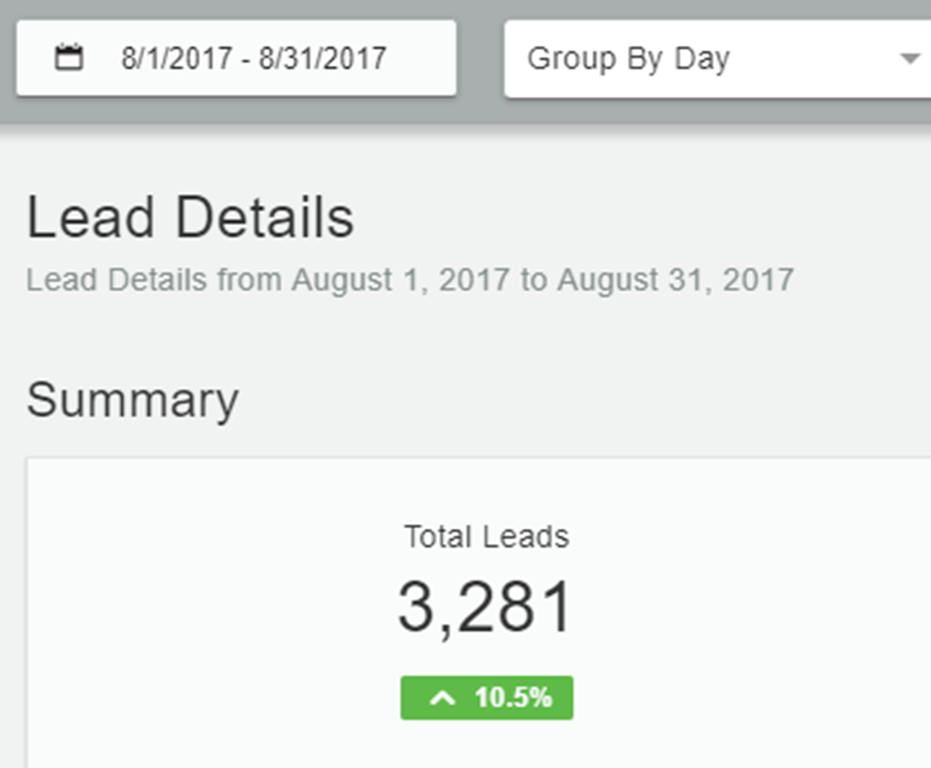
Clearwater Toyota August Market Recap – Digital
Post Click (PC) and Post View (PV) Conversion (Assisted Conversions):
Campaign | Ad Group | Conversions1 PC | Conversions2 PC | Conversions3 PC | Conversions4 PC | Conversions5 PC | Conversions1 PV | Conversions2 PV | Conversions3 PV | Conversions4 PV | Conversions5 PV
CWT Display 2017 | CWT 2017 Display Contextual | 0 | 0 | 0 | 1 | 0 | 5 | 5 | 45 | 47 | 1 | 104
CWT Display 2017 | CWT Retarget | 0 | 0 | 0 | 0 | 0 | 6 | 3 | 52 | 54 | 0 | 115
CWT Video 2017 | CWT Native Video | 0 | 0 | 0 | 0 | 0 | 0 | 0 | 4 | 23 | 0 | 27
CWT Display 2017 | CWT Retarget Bucket 3 | 0 | 0 | 0 | 0 | 0 | 2 | 1 | 0 | 177 | 0 | 180
CWT Display 2017 | CWT 2017 Display Data Super vend | 1 | 0 | 3 | 8 | 0 | 0 | 0 | 5 | 6 | 0 | 23
CWT Spotify 2017 | CWT Audio Spot 1 | 0 | 0 | 0 | 0 | 0 | 0 | 0 | 0 | 0 | 0 | 0
CWT Display 2017 | CWT 2017 Display Contextual Hot Zips | 0 | 0 | 0 | 0 | 0 | 8 | 0 | 11 | 23 | 0 | 42
CWT Rich Media 2017 | CWT Rich Media | 0 | 0 | 0 | 0 | 0 | 7 | 0 | 23 | 18 | 0 | 48
CWT Video 2017 | CWT 2017 Video Data | 0 | 0 | 0 | 2 | 0 | 4 | 1 | 38 | 41 | 0 | 86
CWT Display 2017 | CWT 2017 Display Data | 1 | 0 | 2 | 8 | 0 | 4 | 4 | 33 | 48 | 0 | 100
CWT Video 2017 | CWT 2017 Video Contextual | 0 | 2 | 1 | 0 | 0 | 6 | 6 | 23 | 17 | 0 | 55
CWT Display 2017 | CWT Retarget Bucket 2 | 0 | 0 | 2 | 8 | 0 | 33 | 7 | 75 | 482 | 1 | 608
CWT Display 2017 | Geo fencing | 0 | 0 | 0 | 0 | 0 | 0 | 0 | 0 | 2 | 0 | 2
 | Total | 2 | 2 | 8 | 27 | 0 | 75 | 27 | 309 | 938 | 2 | 1390
Programmatic assisted or was a direct conversion point for 42% of August leads

Slide 4
Clearwater Toyota August Market Recap – Digital
August Optimizations:
Adjusted frequency on video
Added Yahoo to video block list due to poor audio quality
Adjusted bids on retargeting
Updated block list
Looking Ahead:
We will continue to optimize to highest performing sites and data

Slide 5
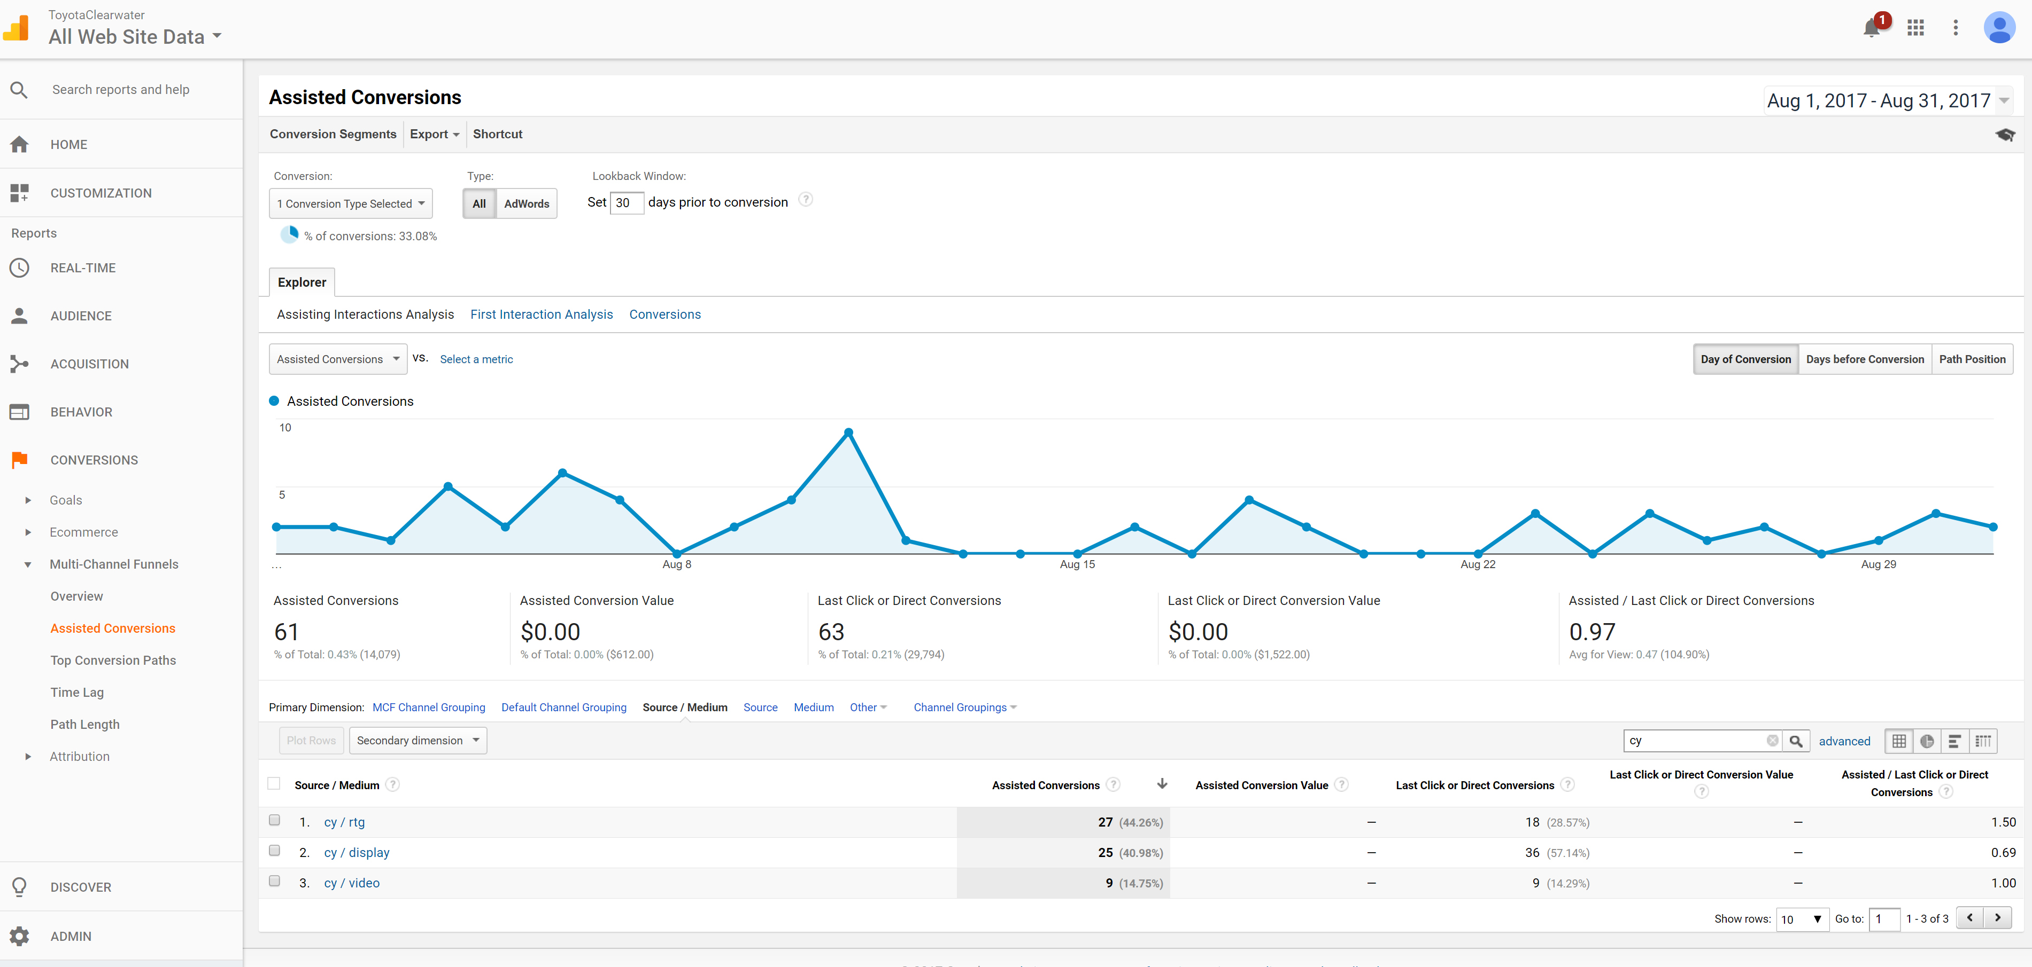
Clearwater Toyota August Google Analytics Snapshot
124 VDP Views

Slide 6
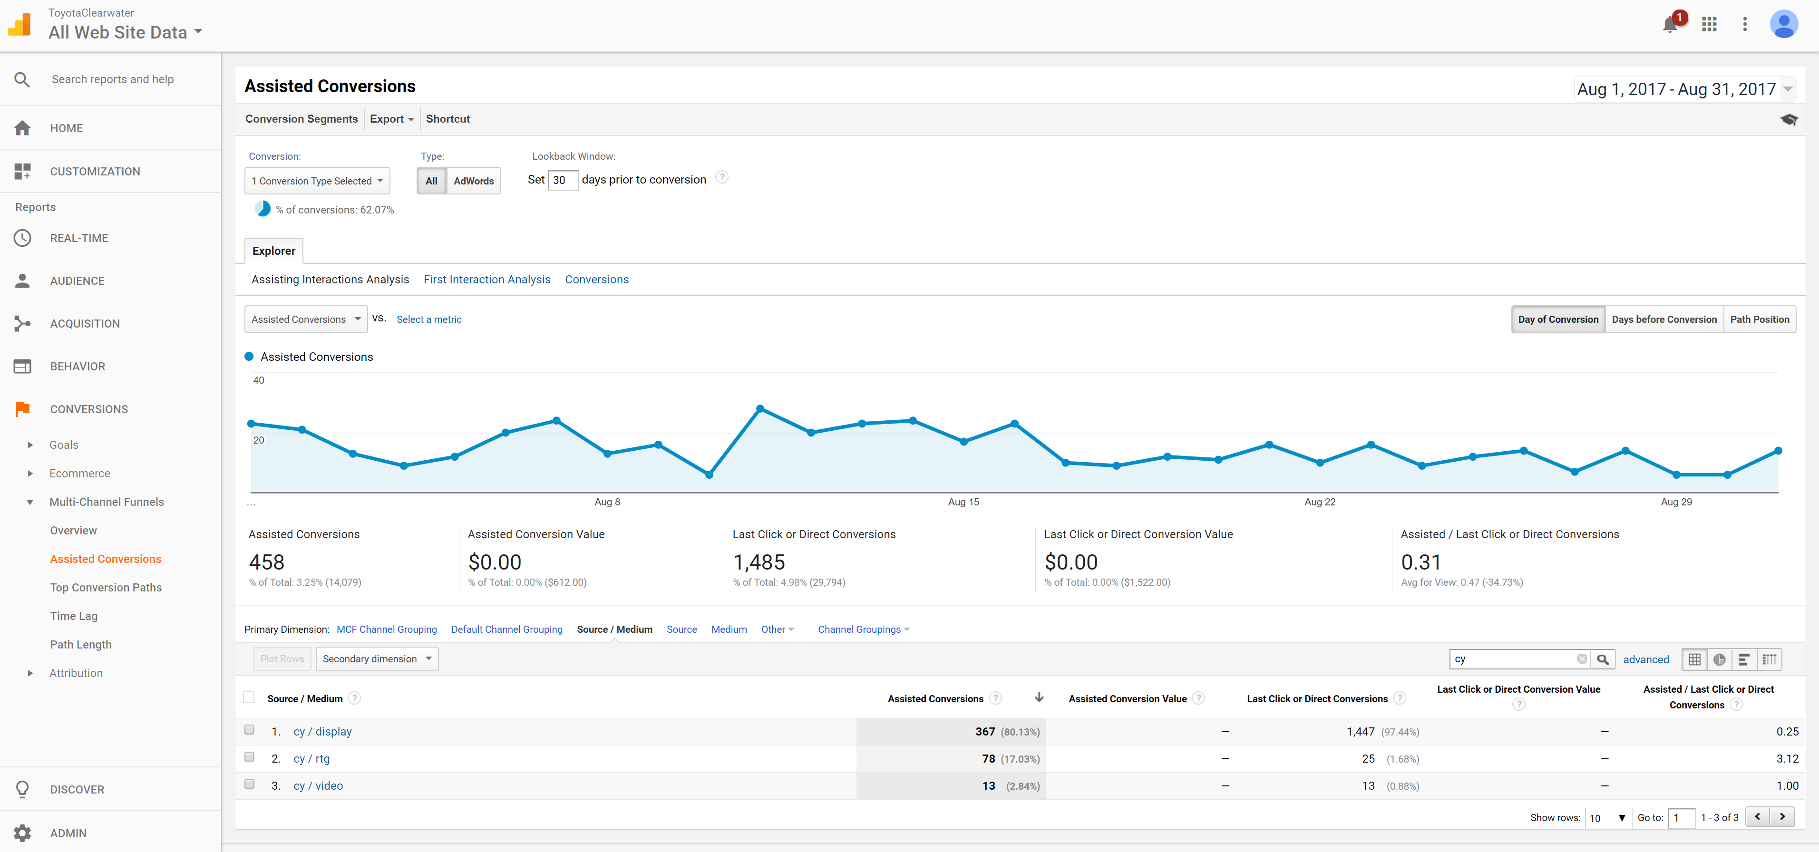
Clearwater Toyota August Google Analytics Snapshot
1,943 VLP Views

