Slide 1
May Market Recap and Look Ahead

Slide 2
Clearwater Toyota May Market Recap
Year over year, advertising spending in the Tampa Bay DMA grew by 71% from $18.372M to $31.417M
Automotive was the top spending category and grew by 57% YOY: May ’16=$5.921M vs May ’17=$9.280M
Out of the top 10 advertisers in the market #3, #6, #7, #8, #9 & #10 were local auto dealers (These included Ford (#3), Toyota (#6), Fuccillo Dealerships (#7), Nissan (#8), Honda (#9) & VW (#10)
CWT advertising spend managed by Connectivity
May ’16=$82,065 vs May ’17=$65,516
CWT May ’17 sales results
NEW budget 210 vs actual 248
Used budget 141 vs actual 141

Slide 3
Clearwater Toyota May Market Recap – Digital
Rich Media:
Generated solid engagement: 2.05% interaction rate (clicked the ad, watched the video).
Spotify:
Moved spend to Pandora due to lack of inventory.
Display:
CTR continues to perform well at .14%.
Geo fence and hot zips performing well.
Retargeting is delivering our best cost per click at $1.69 vs. the average of $4.90 because they are warm leads and brand aware.
Video:
Video continues to perform well at .53% CTR.
Native video leads our CTR at .21%.
Smart Audience Pixel:
The smart audience pixel generates insights into the audience landing on the site.
Insights to demographics are very similar to the audience we are delivering.
We can build audiences around auto propensity for Ford and Lexus conquesting consumers:These are targetable customers who are moderately attached to Ford and Lexus and are open to switching.
GTM Tag Updates:
May set up test retest the triggers.
Looking Ahead:
Investigating developing audience for targeting from rich media ads.
We will begin people based on engagement with the site to move them down to conversion.
Coninued curation of sites and data.

Slide 4
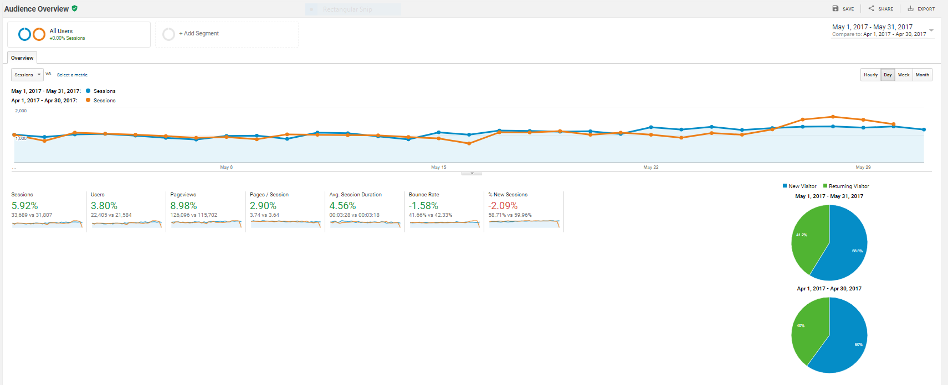
Clearwater Toyota May Google Analytics Snapshot
All key traffic and engagement measurements up vs. prior month with the exception of new sessions; returning visitors up this month since doing retargeting
Looking Ahead:
We have developed a retargeting strategy to reengage people based on engagement with the site to move them down to conversion.

Slide 5
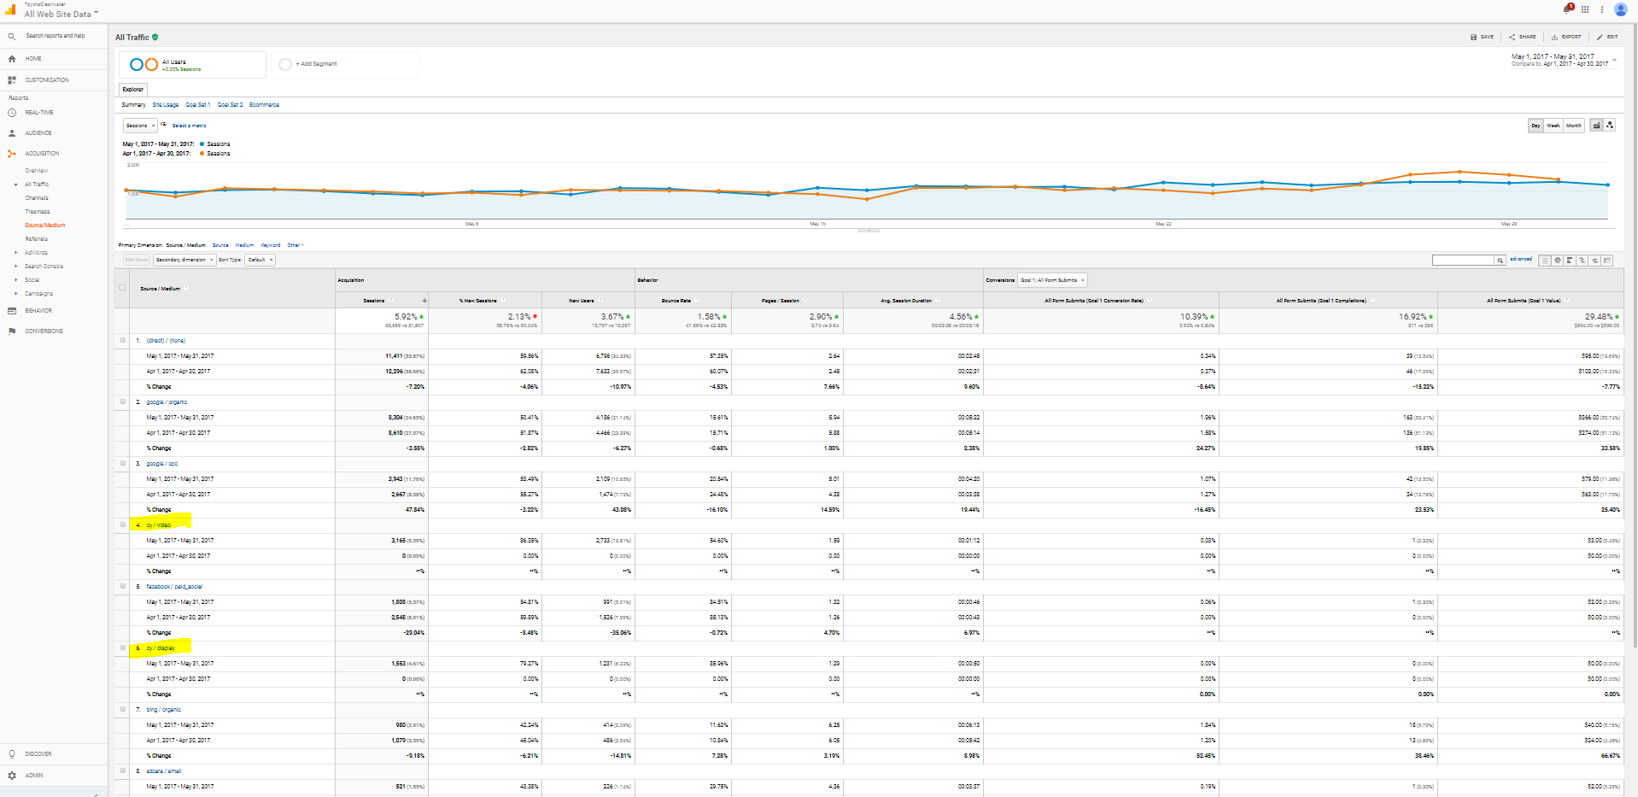
Clearwater Toyota May Google Analytics Snapshot
Display and video are supporting consideration and website traffic while assisting lower funnel conversions for form fills and mobile click to call (9 assisted conversions)

