Slide 1



Market Recap and Look Ahead

Slide 2
Clearwater Toyota January Performance
January Topline Metrics:
Digital Tactics:
Contextual (Display and Video)
Contextual Hot Zips
Data (Display and Video)
Geo Fencing Competitors (Display)
Retargeting (Display)
National CTR Average
.10%.
Ad Group | Impressions | Clicks | CTR
CWT Display Data | 648,618 | 1,162 | 0.18%
CWT Display Contextual Hot Zips | 521,898 | 362 | 0.07%
CWT Display Contextual | 482,233 | 301 | 0.06%
CWT Video Data | 252,440 | 875 | 0.35%
CWT Retarget Bucket 2 | 224,162 | 320 | 0.14%
CWT Retarget | 223,836 | 514 | 0.23%
CWT Video Contextual | 161,914 | 734 | 0.45%
Geo fencing | 93,148 | 240 | 0.26%
CWT Retarget Bucket 3 | 7,653 | 9 | 0.12%
TOTAL | 2,615,902 | 4,517
*We contracted at 2,782,603 impressions for January and underdelivered slightly as CPMs came in higher.
Other Interesting Page Views: 120 VDP views (down from 154) and 1,793 VLP views (up from 1,478)

Slide 3

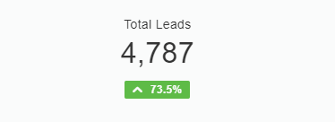
Clearwater Toyota January Performance
Post Click (PC) and Post View (PV) Conversion (Assisted Conversions):
Ad Group | Sonic Price confirm | Contact confirm | Service Confirm | Form Confirm | Finance TY | Sonic Price confirm | Contact confirm | Service Confirm | Form Confirm | Finance TY | Total
CWT 2017 Display Data | 0 | 0 | 0 | 8 | 0 | 0 | 0 | 0 | 317 | 4 | 329
Geo fencing | 0 | 0 | 0 | 2 | 0 | 0 | 0 | 0 | 1 | 0 | 3
CWT Retarget Bucket 2 | 0 | 1 | 0 | 9 | 0 | 6 | 4 | 0 | 722 | 0 | 742
CWT 2017 Display Contextual | 0 | 0 | 0 | 1 | 0 | 0 | 2 | 0 | 40 | 1 | 44
CWT 2017 Video Data | 0 | 0 | 0 | 0 | 0 | 1 | 2 | 0 | 108 | 0 | 111
CWT 2017 Video Contextual | 0 | 0 | 0 | 0 | 0 | 2 | 0 | 0 | 55 | 2 | 59
CWT 2017 Display Contextual Hot Zips | 0 | 0 | 0 | 0 | 0 | 1 | 1 | 0 | 40 | 1 | 43
CWT Retarget Bucket 3 | 0 | 0 | 0 | 0 | 0 | 1 | 0 | 0 | 150 | 1 | 152
CWT Retarget | 1 | 0 | 0 | 1 | 0 | 1 | 0 | 0 | 68 | 0 | 71
 | 1 | 1 | 0 | 21 | 0 | 12 | 9 | 0 | 1501 | 9 | 1554
Programmatic assisted or was a direct conversion point for 32.5% of January leads
Mobile Click to Calls:
2

Slide 4
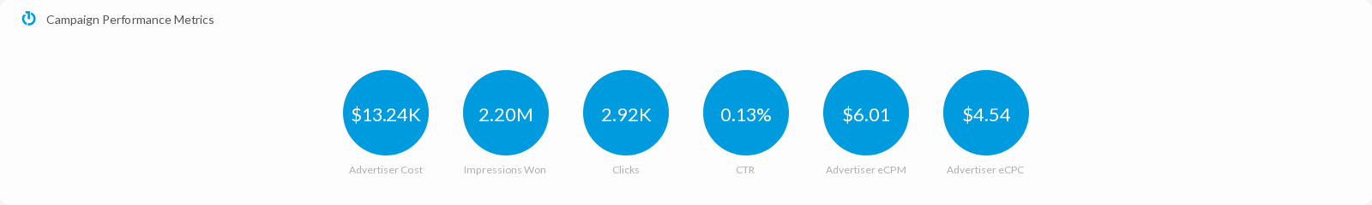
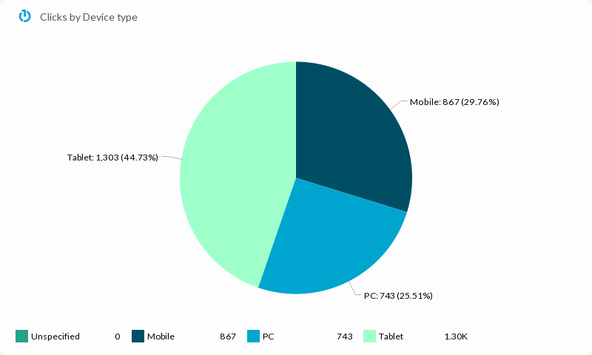
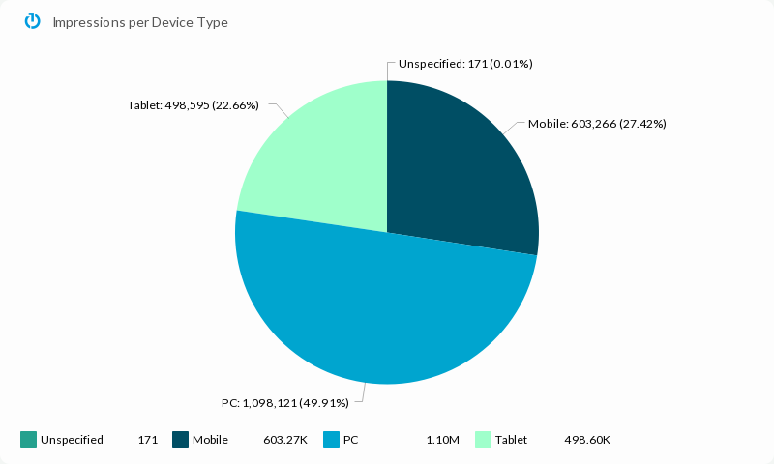
Campaign Performance Metrics – Display

Slide 5
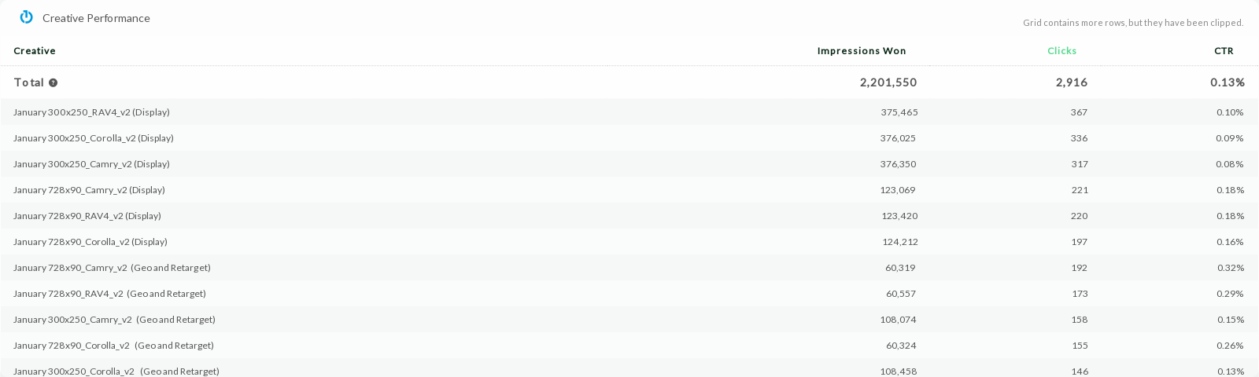
Creative Performance - Display

Slide 6

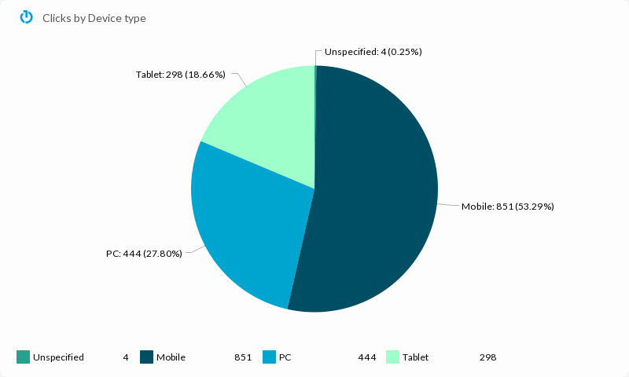
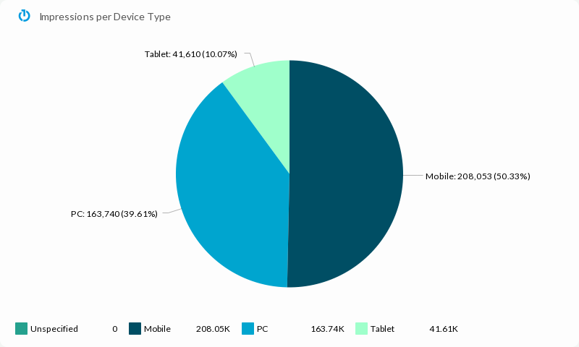
Campaign Performance Metrics – Video

Slide 7
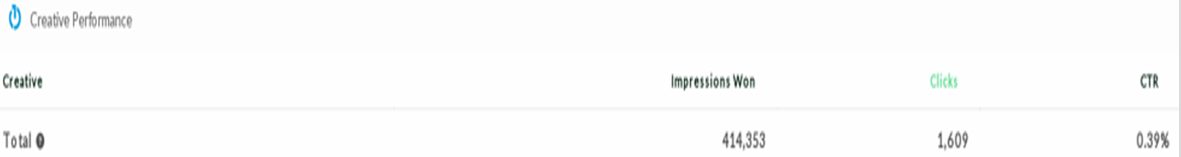
Creative Performance - Video

Slide 8
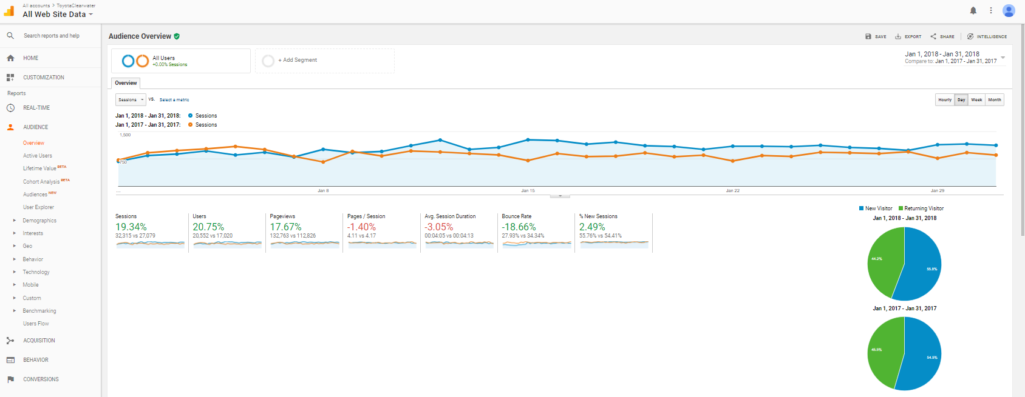
Clearwater Toyota January Google Analytics Snapshot
Sessions, Users, Pageviews, New Sessions Up but Pages / Session and Average Sessions Duration Down

Slide 9
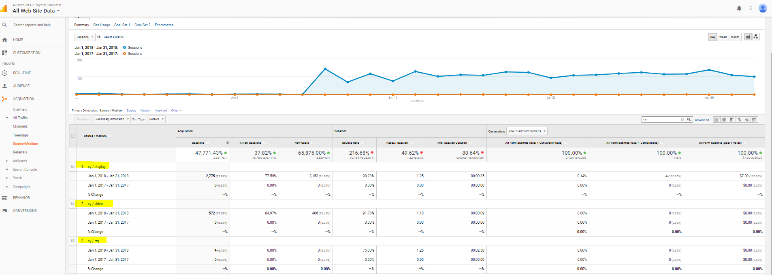
Clearwater Toyota January Google Analytics Snapshot
Connectivity UTM Performance

Slide 10
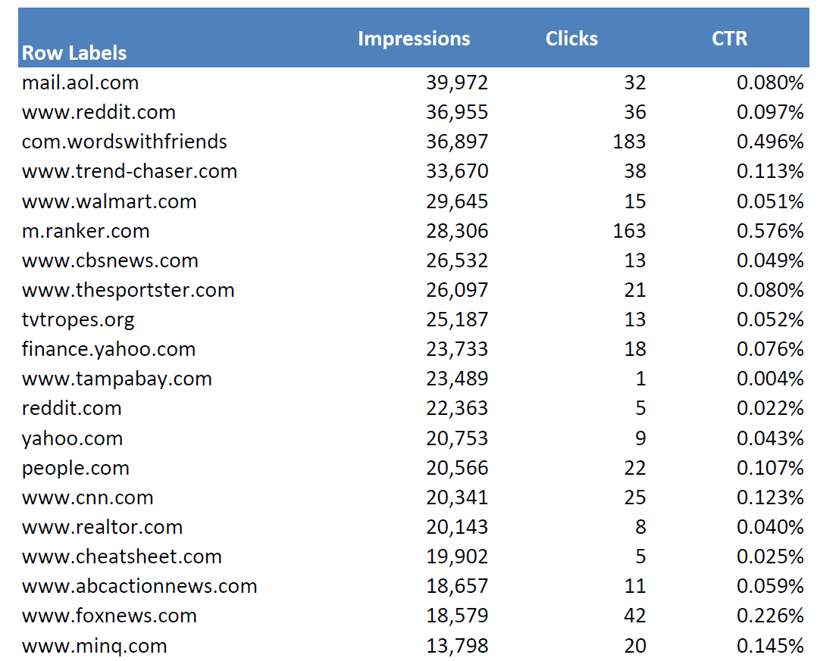
Clearwater Toyota List and Optimizations
Here is a sample of the sites for January:
January Optimizations
Updated Block List
Adjusted bids for spend

