Slide 1
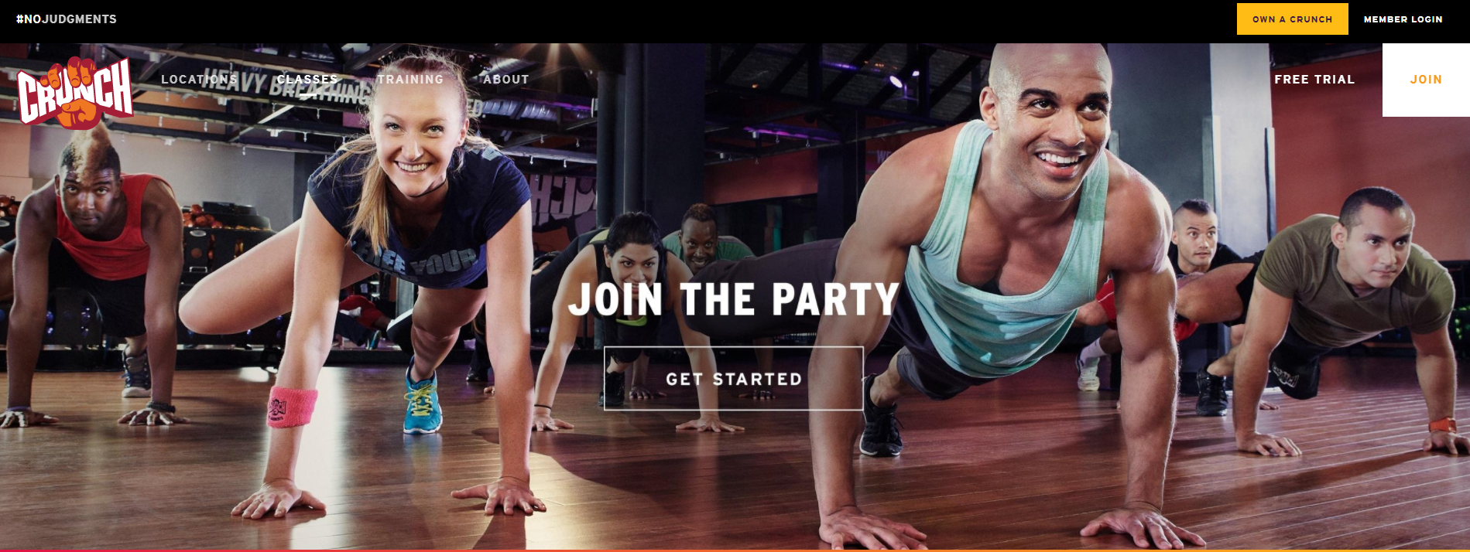
Recap

Slide 2
Crunch Tampa February Performance
Digital Display Tactics:
Contextual / Fitness Sites
3rd Party Data / Fitness Intenders
Performance:
*We contracted for 870,000 impressions and over delivered.
Ad Group | Impressions | Clicks | CTR
Channelside Contextual | 45,024 | 225 | 0.50%
South Tampa Contextual | 47,553 | 280 | 0.59%
Carrollwood Contextual | 50,055 | 174 | 0.35%
Bee Ridge Contextual | 61,749 | 92 | 0.15%
West Bradenton Data | 57,753 | 179 | 0.31%
Sarasota University Contextual | 52,794 | 96 | 0.18%
Bee Ridge Data | 57,990 | 153 | 0.26%
Tampa Palms Contextual | 49,865 | 197 | 0.40%
Bloomingdale / Valrico Contextual | 48,629 | 172 | 0.35%
Sarasota University Data | 53,028 | 119 | 0.22%
Hillsborough Data | 51,935 | 115 | 0.22%
South Tampa Data | 56,532 | 109 | 0.19%
West Bradenton Contextual | 47,927 | 155 | 0.32%
Hillsborough Contextual | 43,300 | 241 | 0.56%
Carrollwood Data | 59,008 | 181 | 0.31%
Tampa Palms Data | 55,804 | 146 | 0.26%
Bloomingdale / Valrico Data | 60,921 | 165 | 0.27%
Channelside Data | 53,317 | 136 | 0.26%
TOTAL | 953,184 | 2,935
National CTR Average
.10%.

Slide 3
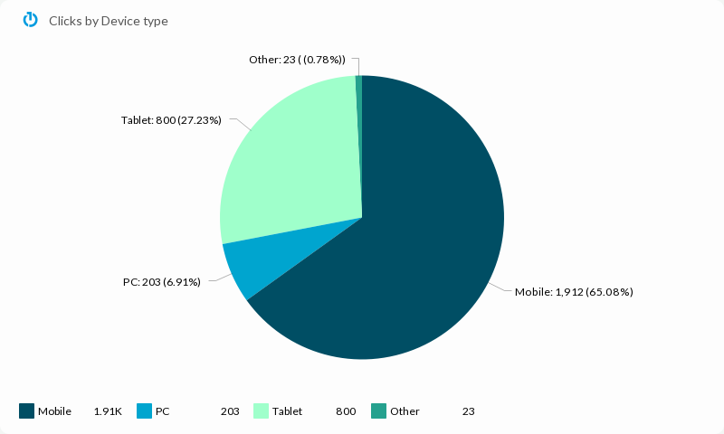
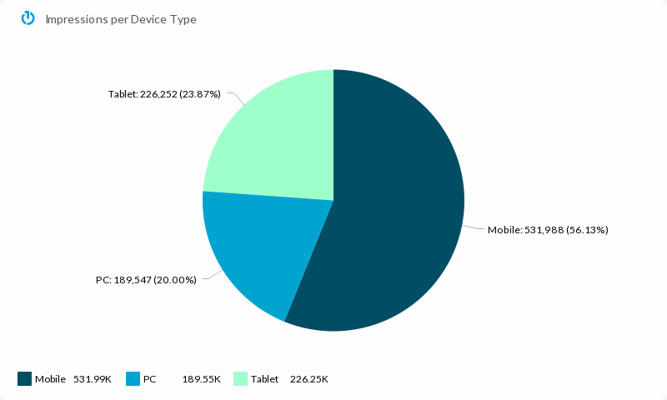
Crunch Tampa Campaign Performance Metrics

Slide 4
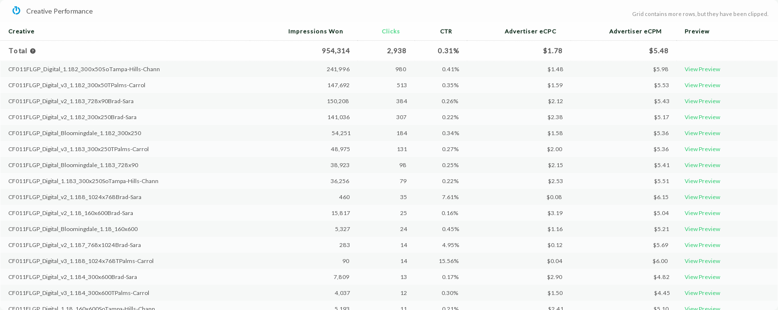
Crunch Tampa Creative Performance

Slide 5
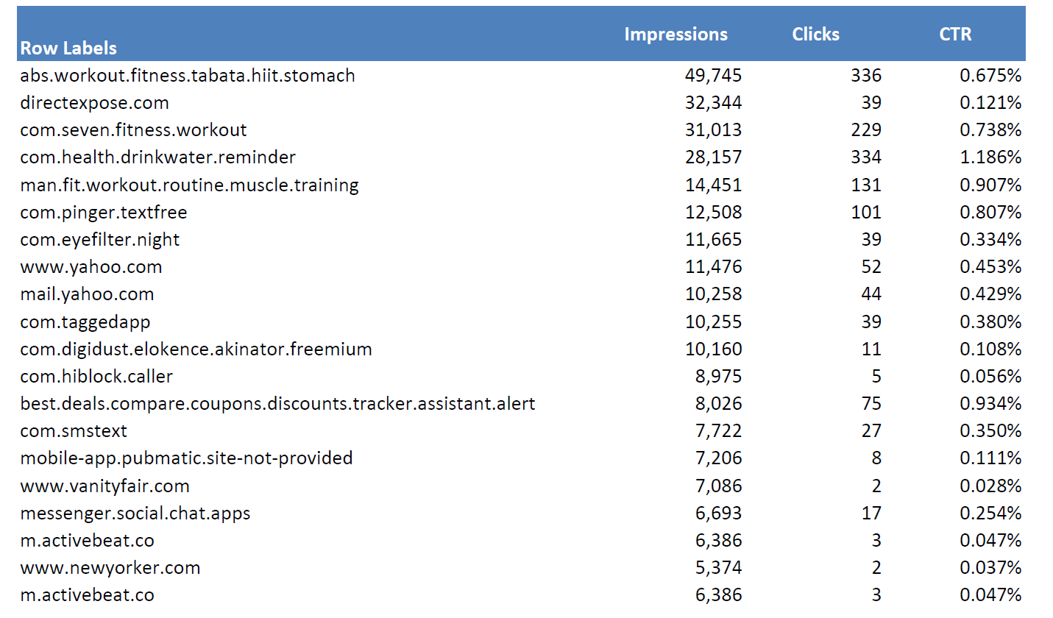
Crunch Tampa Site List and Optimizations
Here is a sample of the sites for February:
February Optimizations
Updated Block List
Adjusted bids for spend

Slide 6
Crunch Snellville February Performance
Digital Display Tactics:
Mobile App Profile Targeting
Ibotta Intent Targeting
Location Based Targeting
Performance:
*We contracted for 250,000 impressions and over delivered.
Ad Group | Impressions | Clicks | CTR
Crunch Snellville - App Profile | 152,255 | 327 | 0.21%
Crunch Snellville - Ibotta | 74,778 | 121 | 0.16%
Crunch Snellville - Location Based Targeting | 73,482 | 121 | 0.16%
Total | 300,515 | 569
National CTR Average
.10%.

Slide 7
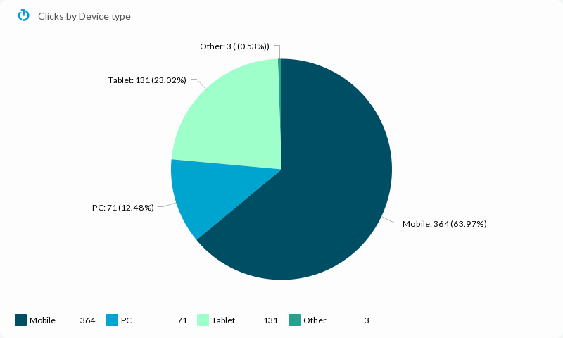
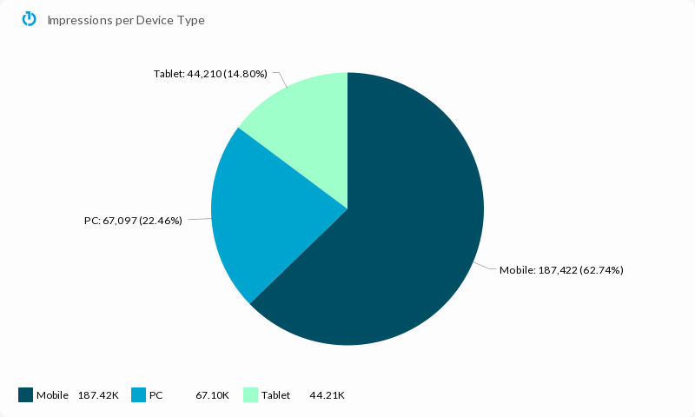
Crunch Snellville Campaign Performance Metrics

Slide 8
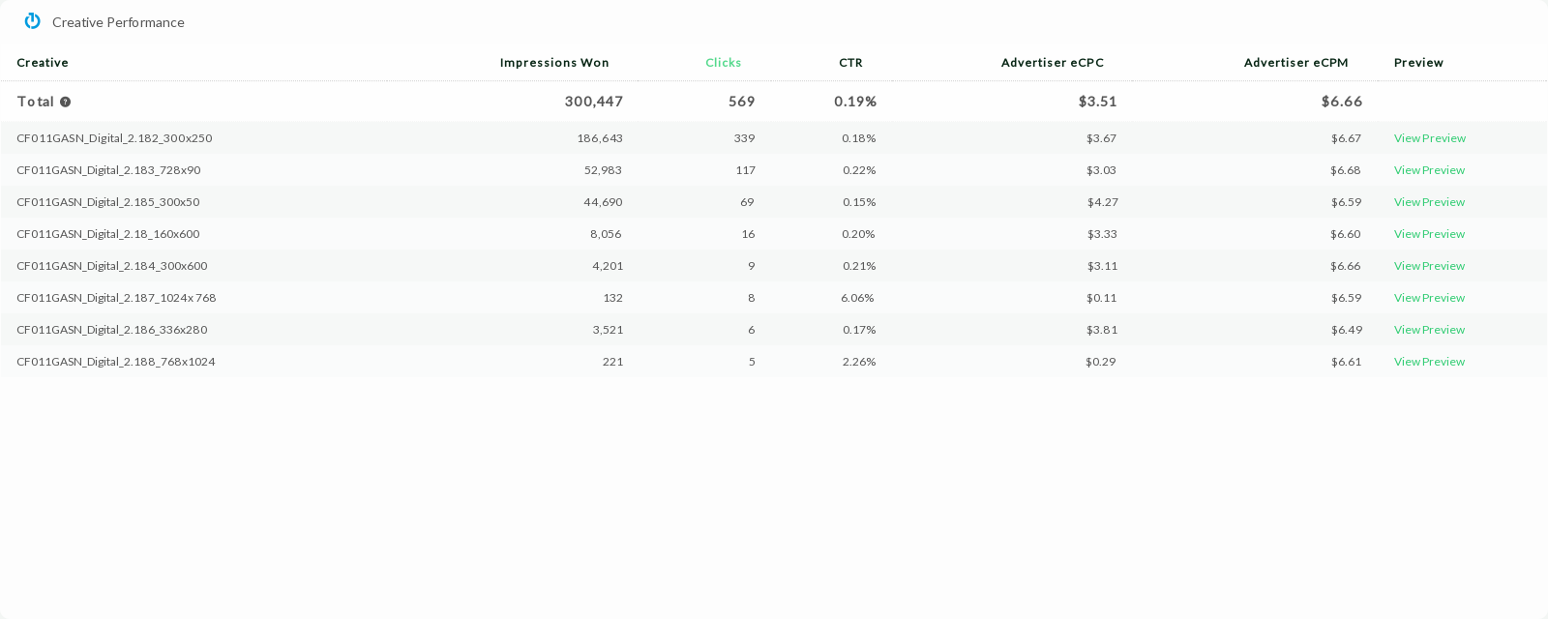
Crunch Snellville Creative Performance

Slide 9
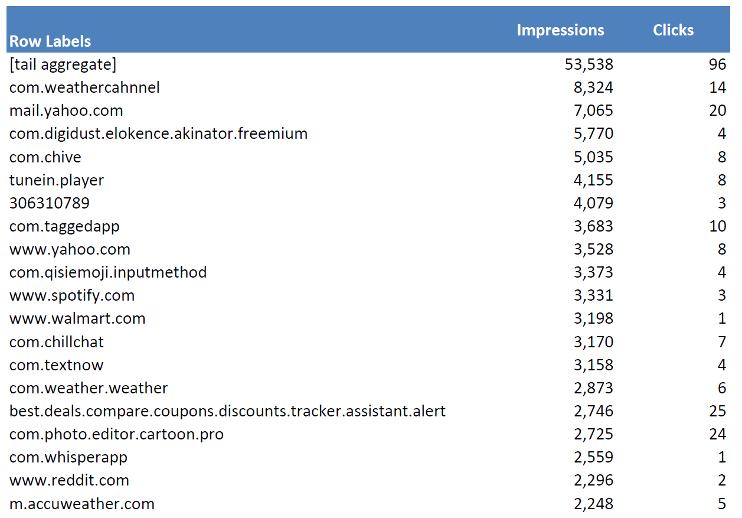
Crunch Snellville Site List and Optimizations
Here is a sample of the sites for February:
February Optimizations
Updated Block List
Adjusted bids for spend

