Slide 1




Black Friday & Holiday
Promotional Support

Slide 2


Leading into one of the most anticipated retail days of the year, The Mike Calta Show would like to host a custom promotion for Gold & Diamond source, encouraging listeners to bring the most unique, creative piece of jewelry they own to win a $500 Gold & Diamond Source giftcard.
GDS will receive:
Minimum of (20) :15 M-SU 6a-12a rec promos – value of $3,000 ($150/promo)
Jock chatter – value of $2,000
GDS to provide:
(1) $500 gift certificate
Gift certificate, copy, logo, any imaging by 11/10
Promotional Value:
$5,000

Slide 3

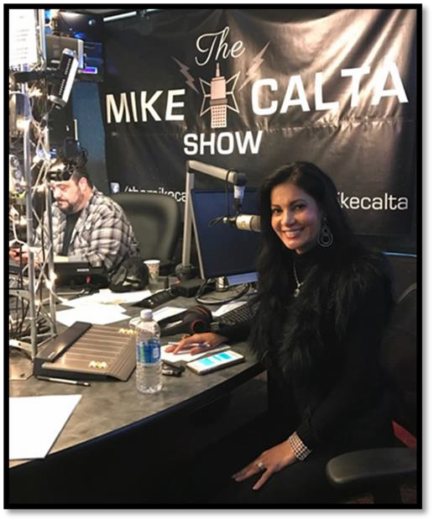

w/ the Mike Calta Show
The holidays are such a special time of the year and The Mike Calta Show will be celebrating in true Mike Calta fashion with a Christmas Karaoke Segment. The Mike Calta Show would love to have Julie live in studio as a guest judge, providing organic on air time to talk on air about all of the holiday gift options available at the Gold & Diamond Source. The winner of the karaoke segment will receive a $1,000 GDS giftcard.
GDS will receive:
Minimum of (20) :15 M-SU 6a-12a rec promos – value of $3,000 ($150/promo)
Jock chatter throughout the week – value of $2,000
Julie on air to co-host 45 minute segment
GDS to provide:
(1) $1,000 gift certificate
Gift certificate, copy, logo, any imaging by 11/10
Promotional Value:
$5,000+

Slide 4







Black Friday & Holiday
Promotional Support

Slide 5


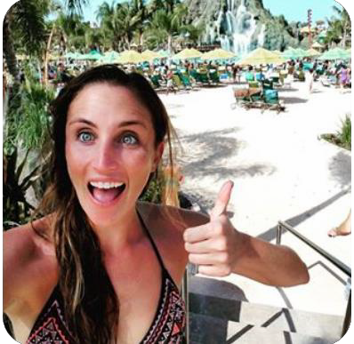
Julie Weintraub Co-Host’s 97X’s 8 @ 8
Sam would love to have Julie Weintraub in to co-host a 30 minute 8 @ 8 countdown segment, where they will count down the top 8 songs. This feature will organically allow Julie to talk about the Black Friday & Holiday Specials!
GDS to receive:
Minimum of (4) interview style breaks with 8 @ 8 Countdown M-F 6a-8p
- value $4,000 ($500/ea)
(1) Social media post with each 8 @ 8 Countdown segment
- value of $800
GDS to provide:
(2) dates for Julie to come in to pre-record
Promotional Value:
$4,800

Slide 6

On Air Giveaways
Additionally, we’d love to host on air giveaways the weeks leading in to Black Friday and Holiday, to plug GDS promotions and specials, reminding listeners of all of the Gold & Diamond Source’s Black Friday and Holiday deals!
GDS to receive:
2 week of On Air Giveaways
- One 11/20
- One 12/18
Minimum of (20) live reads M-F 6a-7p (10 per week)
- value of $5,000 ($250/ea)
GDS to provide:
(10) $250 gift cards in house by 11/10
Promotional Value:
$5,000

Slide 7




Black Friday & Holiday
Promotional Support

Slide 8



Danielle from Magic 94.9 will give Tampa Bay’s Black Friday shoppers the BEST deal of the week…. tickets to Cirque Du Soleil plus a $100 Gold & Diamond Source gift card, reminding listeners to check out all of their Black Friday specials!
There will be daily winners and this promotion will be on air the week leading into Black Friday.
GDS to receive:
(20) M-F AM Drive liners w/ Danielle
  value of $5,000 ($250/ea)
Homepage Slider promoting web contest
  value of $1,000
Giveaways will happen week of 11/20
GDS to provide:
(5) $100 gift certificates
Gift certificates/Pictures/Copy in house by 11/10

Slide 9




Danielle from Magic 94.9 is giving the ULTIMATE HOLIDAY GIFT, tickets to see Moscow Ballet plus a $100 Gold & Diamond Source gift card, reminding listeners to check out the Gold & Diamond Source for all their holiday shopping needs.
There will be daily winners and this promotion will be on air the week leading into Christmas.
GDS to receive:
(20) M-F AM Drive liners w/ Danielle
  value of $5,000 ($250/ea)
Homepage Slider promoting web contest
  value of $1,000
Giveaways week of 12/18
GDS to provide:
(5) $100 gift certificates
Gift Certificates/Pictures/Copy in house by 11/10

