Slide 1
2018
Valentine’s Promotion Recap
Terri Ilgen
terriilgen@iheartmedia.com

Slide 2
Promotion: Big Rig VD Cure
Concept
Valentine’s Day
Big Rig VD Cure
February
2/5 through 2/9 On-Air Giveaways
A 5 day promotion promoting “Big Rig VD Cure” in which Big Rig gave away a $500 G&DS Gift Card at 3:40pm.
10 contesting mentions, 2 per giveaway, valued at $150.00 each
Total: $1,500.00
Custom contest page on www.TampaBaysMix.com for a second chance to win tickets, with a link to partner’s website
Total: $1,000.00
(1) social media blast Includes tagging on Facebook & Twitter. Our current reach is over 40,000 fans/followers!
Total: $1,000.00
Inclusion in (1) Mix VIP email blasts, which reaches over 40,000 plus subscribers
Total: $3,000.00
Inclusion on www.TampaBaysMix.com event calendar with complete details
for Chocolate Fantasy weekend.
Total: $750.00
Promotional Value: $7,250.00

Slide 3
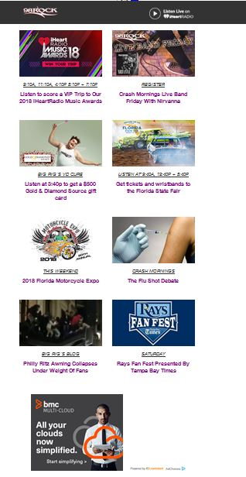
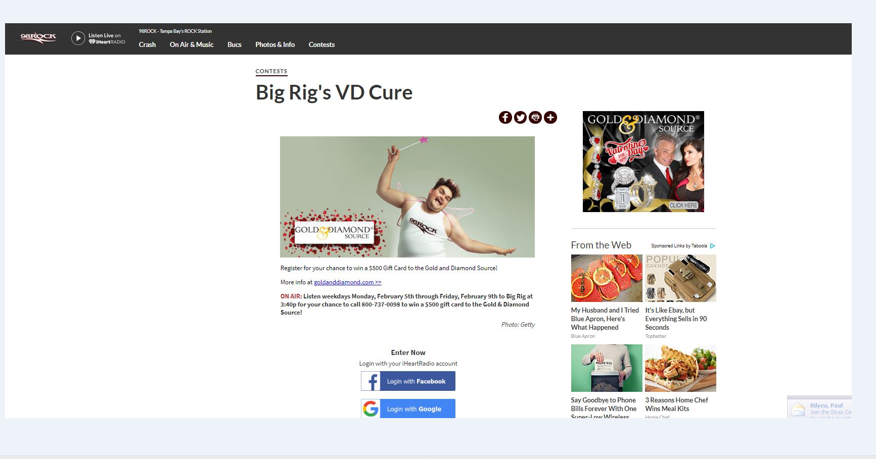
Promotion: Big Rig’s VD Cure
Email Blast
Homepage
Online Contest

Slide 4
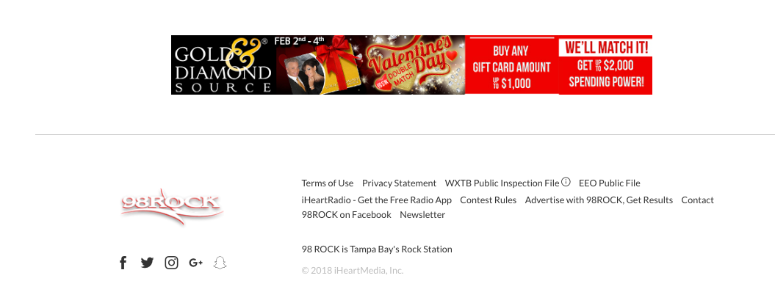
Promotion: Big Rig’s VD Cure
Homepage

Slide 5
Promotion: Country Couple
Concept
Valentine’s Day
Country Couple
February
2/5 through 2/9 On-Air Giveaways
A 5 day promotion promoting “Big Rig VD Cure” in which Big Rig gave away a $500 G&DS Gift Card at 3:40pm.
10 contesting mentions, 2 per giveaway, valued at $150.00 each
Total: $1,500.00
Custom contest page on www.TampaBaysMix.com for a second chance to win tickets, with a link to partner’s website
Total: $1,000.00
(1) social media blast Includes tagging on Facebook & Twitter. Our current reach is over 40,000 fans/followers!
Total: $1,000.00
Inclusion in (1) Mix VIP email blasts, which reaches over 40,000 plus subscribers
Total: $3,000.00
Inclusion on www.TampaBaysMix.com event calendar with complete details
for Chocolate Fantasy weekend.
Total: $750.00
Promotional Value: $7,250.00

Slide 6
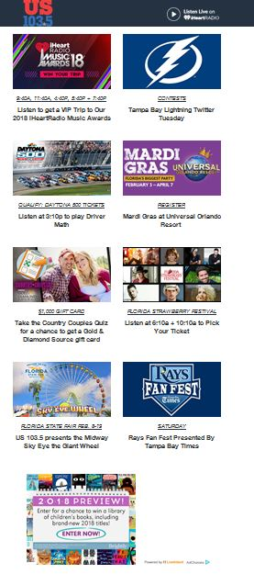
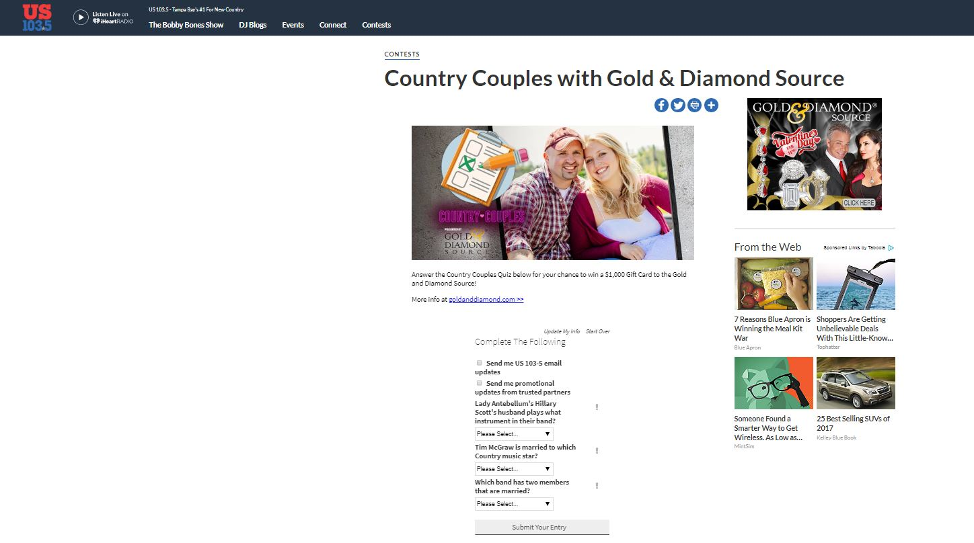
Promotion: Country Couples
Email Blast
Online Contest

Slide 7
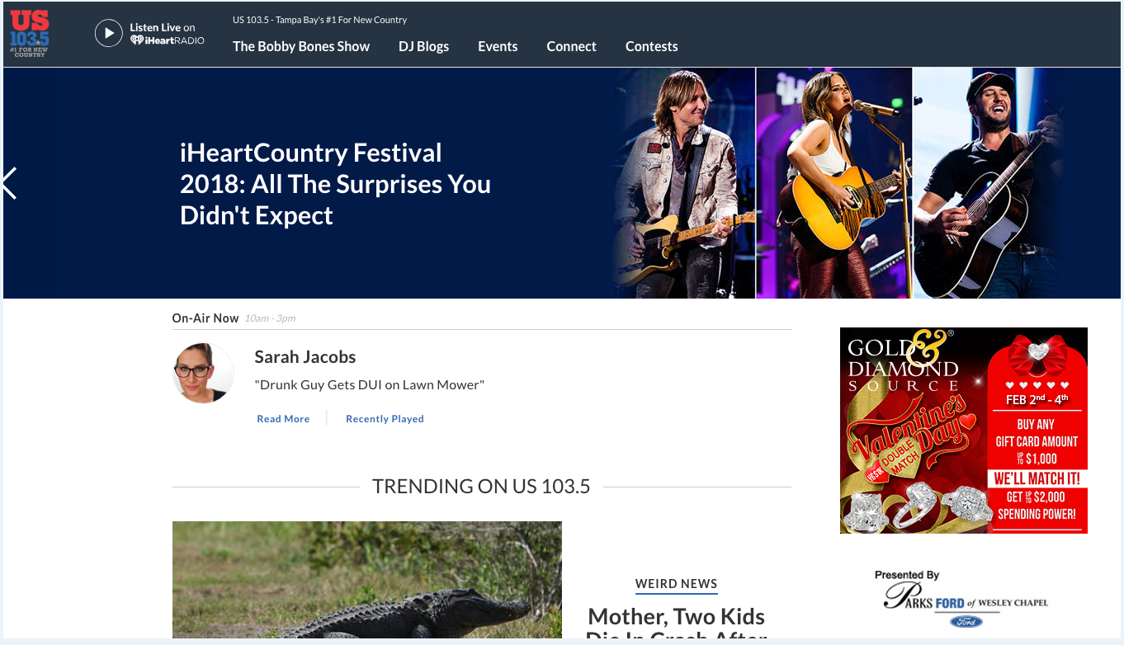
Promotion: Country Couples
Homepage

Slide 8
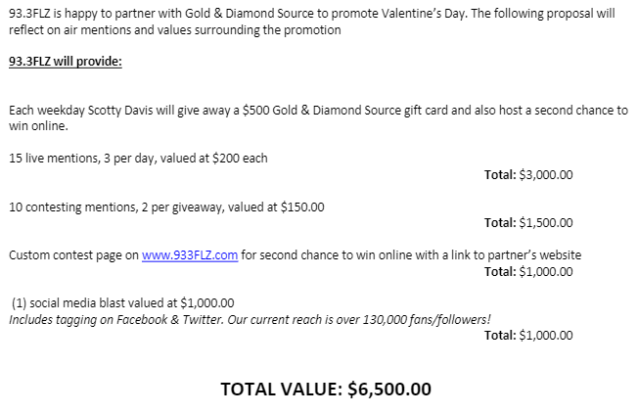
Promotion: FLZ’s Valentine’s Day
Concept

Slide 9
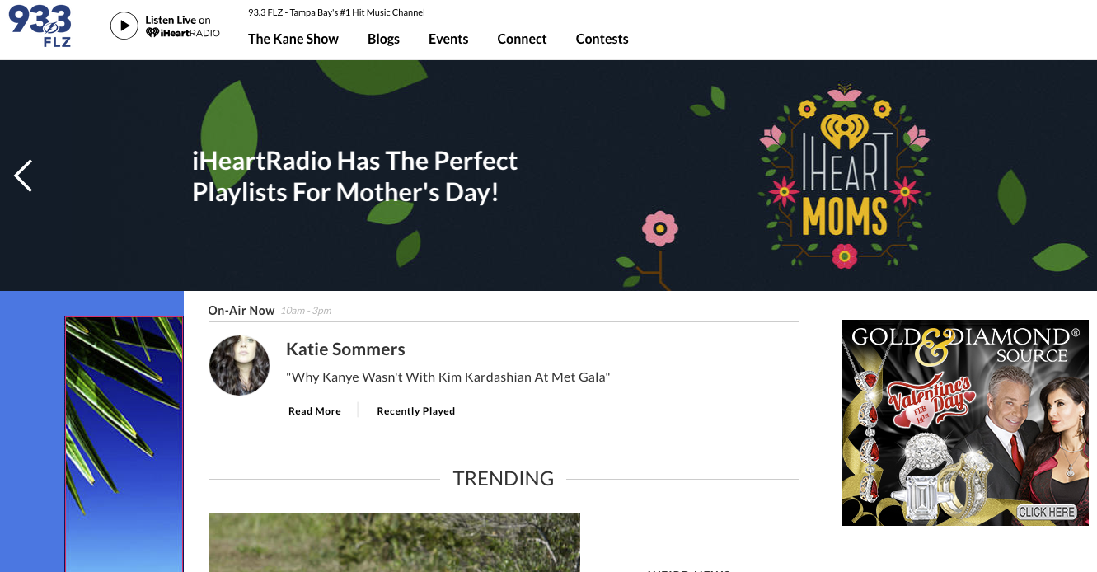
Promotion: FLZ’s Valentine’s Day

Slide 10
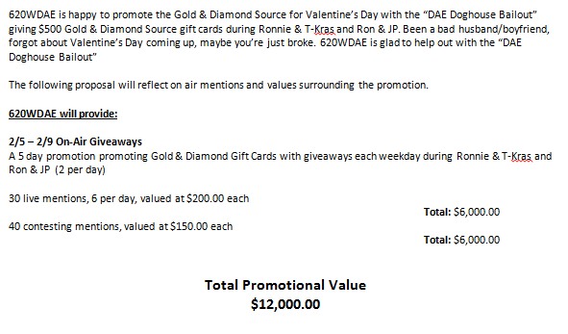
Promotion: Valentine’s Day
Concept

Slide 11
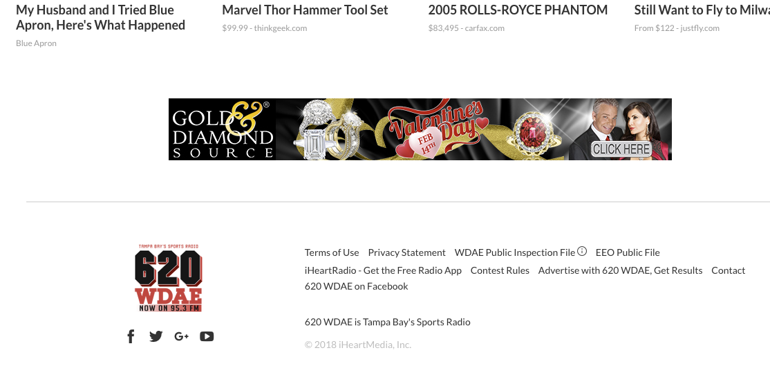
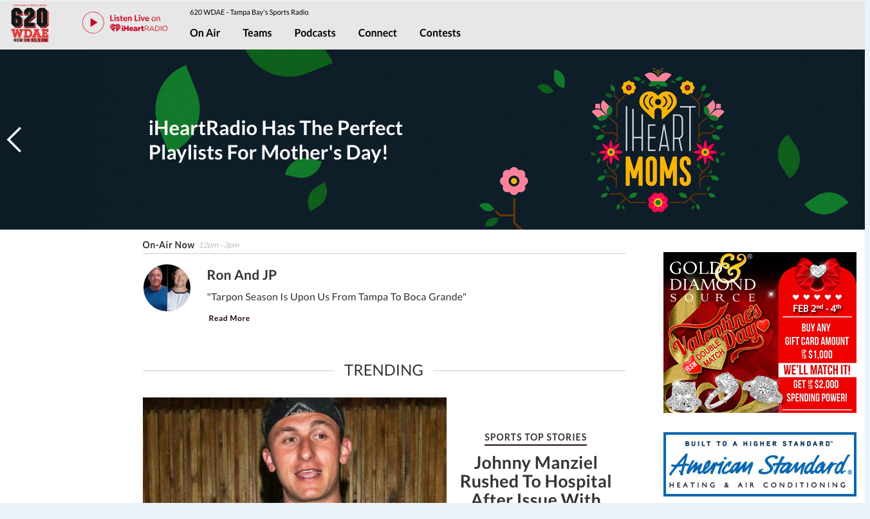
Promotion: Valentine’s Day
Homepage

Slide 12
Spot Times for Julie’s Interviews

Slide 13
Terri Ilgen
terriilgen@iheartmedia.com

Slide 14
Valentine’s Day & Mother’s Day Promotions

Slide 15
2/9-2/11 24 spots per day
Daypart | Spots | Daypart | Spots | Daypart | Spots | Daypart | Spots
12a | 1x | 6a | 1x | 12p | 1x | 6p | 1x
1a | 1x | 7a | 1x | 1p | 1x | 7p | 1x
2a | 1x | 8a | 1x | 2p | 1x | 8p | 1x
3a | 1x | 9a | 1x | 3p | 1x | 9p | 1x
4a | 1x | 10a | 1x | 4p | 1x | 10p | 1x
5a | 1x | 11a | 1x | 5p | 1x | 11p | 1x
Gold & Diamond Source
Valentine's Promo

Slide 16
Julie Weintraub interview with Orlando and The Freak Show
2/9/18 9:20 am

Slide 17
2/7-2/12 24 spots per day
Daypart | Spots | Daypart | Spots | Daypart | Spots | Daypart | Spots
12a | 1x | 6a | 1x | 12p | 1x | 6p | 1x
1a | 1x | 7a | 1x | 1p | 1x | 7p | 1x
2a | 1x | 8a | 1x | 2p | 1x | 8p | 1x
3a | 1x | 9a | 1x | 3p | 1x | 9p | 1x
4a | 1x | 10a | 1x | 4p | 1x | 10p | 1x
5a | 1x | 11a | 1x | 5p | 1x | 11p | 1x

Slide 18
Gold & Diamond Source Valentine's Promo
February 7th-12th
8x :30 spots 6a-12a
2/13 12:15pm; 12:30;12:45
2/12 12:20pm; 12:30;12:45
2/9 12:15pm; 12:30;12:45
2/8 12:15pm; 12:30;12:45
2/7 12:15pm; 12:30;12:45

Slide 19
Promotional Outline
GOLD AND DIAMOND SOURCE (VALENTINES DAY)
Flight Dates: 5/7-5/11
92.5 MAXIMA will run a one (1) week on-air giveaway for GOLD AND DIAMOND SOURCE MOTHER’S DAY. Listeners will wait for cue to call during our mix at 12pm for their chance to win a $250 GDS Gift Card.
Flight dates are May 7 thru May 11.
Please review the following support below:
92.5 Maxima to provide
Inclusion in minimum of (10) live mentions and 10 recorded promos
Inclusion on station e-mailer to approximately 9,000 loyal listener subscribers.
Web contest featured on 925maxima.com homepage rotator.
Gold and Diamond Source to provide:
(6) Gift cards valued at $250 each for on-air and online giveaways.
Copy points for promos and live liners
Graphics for website
Approximate promotional value: $8500
*** Promotion pending availability until confirmed by both parties

Slide 20
The Current
Valentine’s Day
The Current
Mindset Matters
The Current
WiLD 94.1 FM: Sundays from 6-7 A.M.
WBRN 98.7 FM: Sundays from 6-7 A.M.
99.5 WQYK FM: Sundays from 11 P.M.-12 midnight
99.5 WQYK HD2: Sundays from 10-11 P.M.
(HD Radio)
104.7 Q105 FM: Sundays from 5-6 A.M.
104.7 Q105 HD2: Saturdays from 6-7 A.M.
(HD Radio)
Money Talks 1010 AM: Sundays from 6-7 A.M.

Slide 21
Valentine’s Day Promotions
2018
Presented By: Kourtney Thompson

Slide 22
Love Song Karoke
CONTINUES on The Mike Calta Show
Calta Karoke has become a staple feature on The Mike Calta show. We’d love to continue the momentum having the Gold & Diamond Source sponsor the segment, inviting Julie in studio to be a guest judge. The 45
minute segment provides opportunity to showcase all of GDS’ Valentine’s
Day specials.
Promotional Concept:
We will encourage listeners to tune into Calta Karaoke’s Valentine’s Day Special. The
karaoke participants will play for a show listener and the winner (listener) will receive a
$500 gift certificate to the Gold & Diamond Source.
GDS to receive:
Minimum of (20) :15 M-SU 6a-12a rec promos – value of $2,000 ($100/promo)
Chatter throughout the 45min-1hr segment – minimum value of $3,500
GDS to provide:
(1) $500 gift certificate
Gift certificate, copy, logo, any imaging by 1/26
*contingent upon programming approval

Slide 23
Win the ultimate
Valentine’s Day treat….
Danielle is giving away the ultimate Valentine’s Day prize pack equipped with Cirque Volta tickets PLUS a $250 Gold & Diamond Source gift card!
GDS to receive:
Daily giveaways will run the week of 2/5
(20) M-F 6a-7p live liners where Danielle will talk about GDS
Valentine’s Day Specials
value of $5,000 ($250/ea)
Homepage Slider promoting web contest
value of $1,000
2 minute on air interview between Julie and Danielle
This segment will air the Friday before Valentine’s Day. It
will be pre-recorded.
value of $2,500
GDS to provide:
(5) $250 gift certificates for daily grand prize winners
Gift Certificate/Pictures/Copy/Imaging in house by 1/26

Slide 24
With Sam
Three Track Snack is a daily on air segment where listeners pick the artist that we play at noon. We play 3 songs of the same artist back to back.
Sam starts to encourages listeners to submit bands around 11 and pulls a winner @ 12n. The winner gets to pick the artist/band and will receive a $250 Gold & Diamond Source gift certificate, reminding listeners that GDS is the only place they need to go for that perfect Valentine’s Day gift!
GDS will sponsor this daily feature for 1 week leading into Valentine’s Day AND we’d love to invite Julie come in to co-host the Friday segment. This will run the week of 2/5. To continue promotion into the week of Valentine’s Day, Sam will continue daily on air giveaways (M-W), where she will talk about GDS’ Valentine’s Day specials.
GDS to receive:
Three Track Snack Sponsorship the week of 2/5
SAM
WEEKDAYS 3PM-6PM
(10) live reads during the Three Track Snack Segment – value of $2,500 ($250/ea)
Julie to co-host the segment that will air one day during the week of 2/5 – minimum value of $2,500
2-3 breaks to talk about the GDS Valentine’s Day specials
Social media posting – value of $400 GDS to provide:
(8) $250 giftcards
(5) given away the week of the Three Track Snack sponsorship
(3) the week of 2/12
Gift certificate, copy, logo, any imaging by 1/26

Slide 25
Valentine’s Day is around the corner…. Make sure to find something special for the one you love at The Gold & Diamond Source! 107.3 The Eagle is giving you the chance to win a $250 Gold & Diamond Source gift certificate!
Promotional Concept:
107.3 The Eagle will host an online contest where listeners will register for their chance to win a $250 gift certificate to the Gold & Diamond Source. This web contest will be supported online and through on air promos, enforcing the message that any Valentine’s Day shopping can be taken care of at
the Gold & Diamond Source.
GDS to receive:
- (30) :15s M-SU 12a-12a running 1/29 + 2/5 – value of $1,980
Custom web contest page on www.1073theeagle.com – value of $1,000
GDS to provide by 1/27:
(1) $250 gift certificate
Gift certificate, copy, logo, any imaging by 1/26

Slide 26
Valentine’s Day is around the corner…. Make sure you find something special for the one you love at The Gold & Diamond Source! 105.5 The Dove is giving listeners the chance to win a $250 Gold & Diamond Source gift certificate!
Promotional Concept:
105.5 The Dove will host an online contest where listeners will register for their chance to win a $250 gift certificate to the Gold & Diamond Source. This web contest will be supported online and through on air promos, enforcing the message that any Valentine’s Day shopping can be taken care of at
the Gold & Diamond Source.
GDS to receive:
- (30) :15s M-SU 12a-12a running 1/29 + 2/5 – value of $1,980
Custom web contest page on www.wduv.com – value of $1,000
GDS to provide by 1/27:
(1) $250 gift certificate
Gift certificate, copy, logo, any imaging by 1/26

Slide 27
Spot Manager: Placed, 02/09/18-02/09/18
02/09/18 6:54:21 PM $0.00 Paraiba MarkeVALENTINE'S DAY INTERVIEW
Date | Air Time | Rate | Advertiser | Ad-ID | Station | Length
WWRM-FM
2:00
 | $0.00
[Sorted by: Date]
Spot Manager: Placed, 02/09/18-02/09/18 (05/04/18 4:55:14 PM)
Page 1 of 1

